Slide 1
Texas Bullet Train
Student’s Name
Institutional Affiliation
Notes:
The presentation will thoroughly cover the Texas Bullet train and its various aspects.

Slide 2
The Texas Bullet Train
The Dallas speed bullet train will run on high speed railway track.
Texas bullet train will be a high speed N700-I train.
It will connect Texan cities of Houston and Dallas.
Train tracks will be 240 miles long
The train will be electric and will reduce the travel time between the two cities to just 90 minutes (Texas Central, 2018).
Notes:
The Texas bullet train will run on a 240 mile long high speed train tracks. The train used will be the N700-I model similar to those used in japan and whose technology has been tested and its safety records proven. The bullet train will connect the cities of Dallas and Huston and reduce the travel time to just 90 minutes

Slide 3
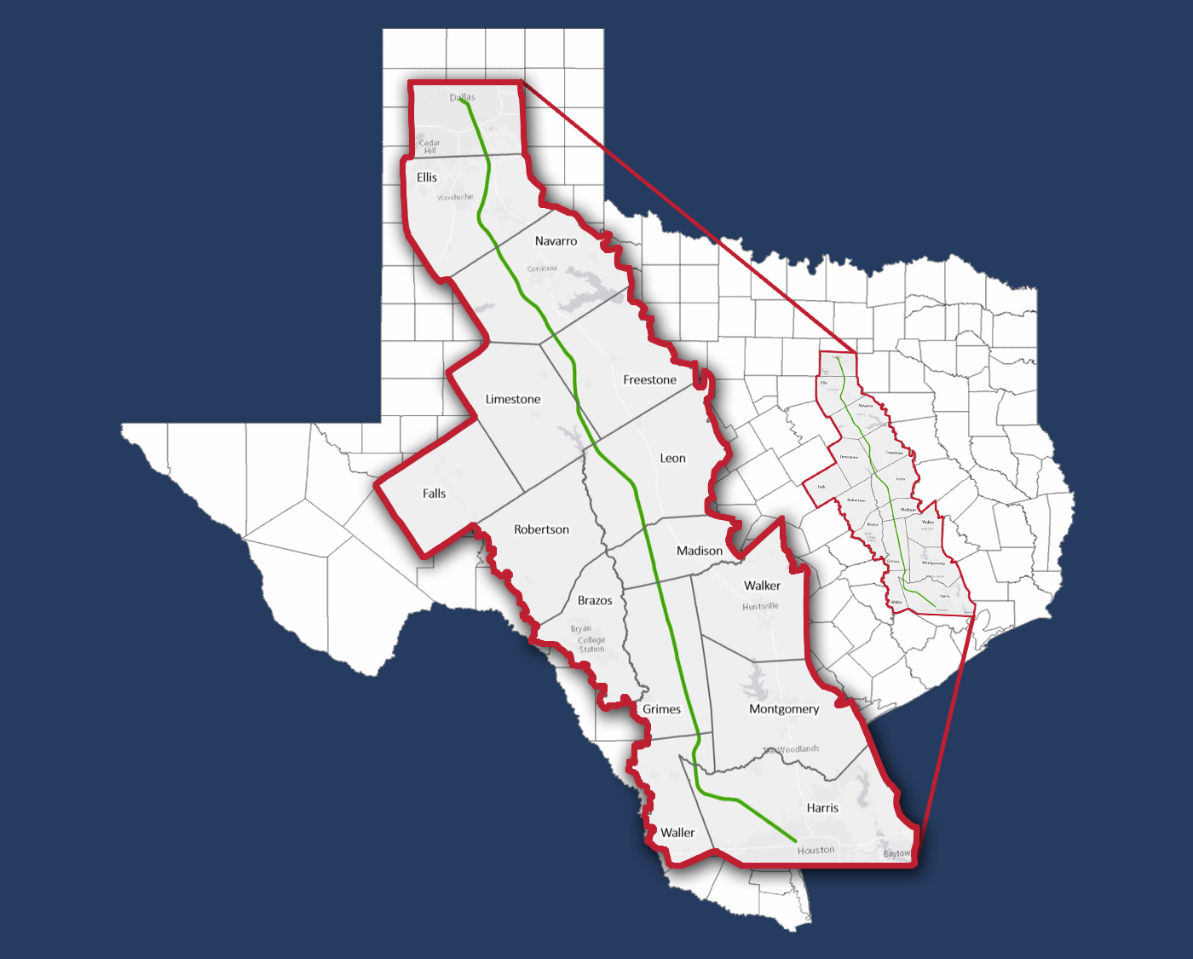
Location Of The Train Tracks
According to Texas Central (2018), the train tracks will run through the counties of Dallas, Ellis, Navarro, Limestone, Freestone, Leon, Madison, Grimes, Wailer and Harris.
Notes:
The train tracks aims at avoiding disruption of ranching activities as well as the use of private property as much as possible. In this light the proposed route will follow already existing utility lines and will transverse the counties ofDallas, Ellis, Navarro, Limestone, Freestone, Leon, Madison, Grimes, Wailer and Harris.

Slide 4
Location Of The Train Stations For The Texas Train
There will be no intermediate train stations.
Three stations will exist one Houston, another one in the Brazos valley and another one in Dallas.
Only potential sites for the Dallas stations have been established.
The first potential Dallas station location is in cedar district.
This station is undeveloped and will be approximately 10-20 acres in size (Railway Technology, 2018).
The second site is along interstate 30
Notes:
There will be only three train station along the Dallas-Houston bullet train route.
The first station will be in Dallas .
Located in the Cedars (South Side on Lamar) area, the currently undeveloped land includes the 10 to 20 acres needed for the terminal station and parking.
The Houston and Brazos valley stations locations have not been announced yet.

Slide 5
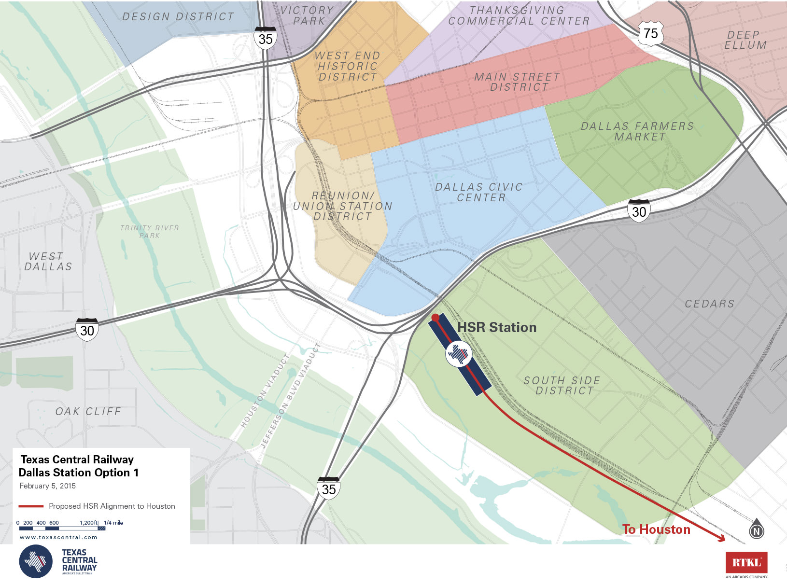
The Dallas Station

Slide 6
Future Construction Plans
The Dallas stations are strategically located to allow for future high speed railway projects.
Plans are in place to increase the high speed railway connectivity in Texas connecting Dallas to Arlington and fort worth which is under construction.
The train will run on newly installed tracks which will be exclusive to the bullet train(Texas Central, 2018).
Notes:
The location of either of the sites will allow future connectivity with another public high-speed rail project that would connect Dallas, Arlington and Fort Worth, which is currently under consideration.
The train will run on its own specialized electric track.
The train tracks will be designed and installed by American based companies and contractors

Slide 7
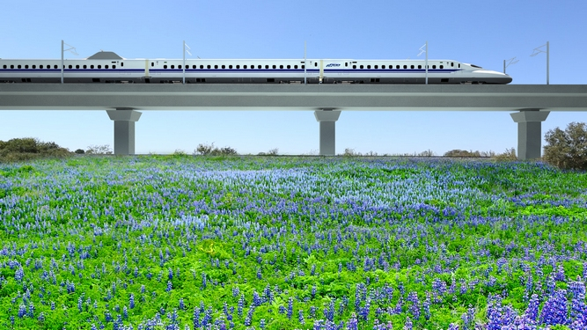
The Texas Bullet Train Tracks
Train tracks will be mostly elevated.
This will promote safety and minimize environmental degradation
The tracks will follow utility power lines for electric supply.
Operational efficiency will also be maximized (Natural Awakenings Magazine, 2018)
Notes:
60 Percent of the train tracks will be on elevated beams.
This is so as to minimize the impacts of the bullet train on existing infrastructure and structure.
Additionally the elevated tracks to reduce impacts of the train on the environment.

Slide 8
Effects Of The Noise Caused Train On Livestock
The Dallas-Houston bullet train station based noise pollution will be zero.
The bullet train will run on the quietest system globally.
Therefore livestock will be minimally affected by noise from the rapid displacement of air by the train.
The minimal effects on the community and livestock will be mitigated through cost incurred by the project(Natural Awakenings Magazine, 2018).
Notes:
Environmental surveys found that the train stations of the Dallas-Houston bullet train will result I n zero noise poluutions.
The train will not have massive noise pollution impacts as the technology has been developed and perfected in other parts of the globe to be the quietest system in the world.
The will be minimal effect on livestock as the train tracks will be elevate and there will also be a 500 feet right of way policy in ranches.
Additionally, the project costs includes funds for mitigating damages and effects of the train on the community as well as economic activities such as livestock keeping.

Slide 9
Technical Objectives Of The Dallas-Houston Bullet Train
Fast travel between the city’s of Dallas and Houston.
Safe travel between the two cities.
Alleviation of pressure on current Texas transport infrastructure.
No train technology will be developed.
The train technology used will be similar to the one used in japan, the trains used will be the N700-I trains.
Reduction of transport costs (Railway Technology, 2018)
Notes:
The objectives are the Improved travel speeds between the cities of Dallas and Houston.
Additionally, the bullet train is proven to be safe as it has never derailed in over 60 years of its existence.
The train technology used has been in existence for over 50 years and has been perfected through its use in countries like japan.
The train aims to reduce transport costs by saving up to 81.5 million gallons of fuel annually.

Slide 10
Sociological Impacts Of The Dallas-Huoston High Speed Railway
Some family or individually owned property will be lost although compensations will be made.
Faster, comfortable and efficient travel.
The standards of living will be improved through job creation.
Approximately 1500 permanent jobs will be created from the project.
The jobs will be in the train stations, train operations, management of the trains and railways as well in the maintenance and monitoring of the train tracks.
Notes:
Socially conflicts are arising from the expected loss of ranch lands by landowners in Texas.
The second social effect will be appositive one and will be the improvement of travel speed, comfort, quality and safety between Dallas, Brazos valley and Houston.
Additionally, the standards of living of many Texans will improve through the creation of over one thousand five hundred jobs

Slide 11
Environmental Objectives
Reduction of environmental pollution caused by the transport sector.
Reduction of noise pollution caused by train station activities.
Free movement of wildlife and reduced interruption by train crossings.
Lower per passenger emissions Texas (Central, 2018).
Notes:
Various environmental objectives from the same emerge. Reduction of environmental pollution caused by the transport sector.
Reduction of noise pollution caused by train station activities. Free movement of wildlife and reduced interruption by train crossings.
Lower per passenger emissions Texas (Central, 2018).

Slide 12
References
Natural Awakenings Magazine.(2018). Dallas to Houston Bullet Train is Electric. Retrieved from https://www.nadallas.com/DAL/June-2018/Dallas-to- Houston-Bullet-Train-is-Electric/
Railway Technology. (2018). Dallas to Houston High Speed Rail, Texas. Retrieved from https://www.railway- technology.com/projects/dallas- to-houston-high-speed- rail-texas/
Texas central. (2018). The Texas Bullet Train. Retrieved from https://www.texascentral.com/project/

